Slide 1
Cleveland Housing Hackathon
April 7th, 2017

Slide 2

JumpStart unlocks the full potential of diverse and ambitious entrepreneurs to economically transform entire communities.

Slide 3

Core City: Cleveland Program
Provides assistance to entrepreneurs and small business owners in the city of Cleveland to help grow their businesses and create jobs.
www.jumpstartinc.org/corecity
Supported By:

Slide 4
Office Hours
(By Appointment Only)
In these free 1:1 sessions, you’ll receive:
Business direction and guidance
Value-driving key tasks for the entrepreneur to complete
Connections to other community business resources
To schedule an appointment, email us at corecity@jumpstartinc.org.

Slide 5













Intro to the Collaborator Network
13 Collaborators
Akron Global Business Accelerator (AGBA), BioEnterprise, BioHio, Braintree, FlashStarts, GLIDE, JumpStart, MAGNET, NEOMED, Ohio Aerospace Institute (OAI), TBEIC, U of Akron Research Foundation (UARF), Youngstown Business Incubator (YBI)

Slide 6
The Agenda
Top factors that determine startup success
It’s all about assumptions
Minimum viable products

Slide 7
Top factors that determine startup success?
Bill Gross started Idealab, the longest running technology incubator (150 companies with 45+ IPOs and acquisitions)
He did a quantitative analysis of 200 startups to pinpoint what factors most influence a company’s success or failure
Some of the companies included in the analysis: YouTube, Uber, Pets.com, Instagram, AirBNB, Kozmo, LinkedIn, Friendster
Guess what factors he found to have the greatest impact on startup success?

Slide 8
Top factors that determine startup success
Funding - 14%
Business Model - 24%
Ideas - 28%
Team - 32%
Timing - 42%
http://www.inc.com/chris-dessi/this-ted-talk-explains-the-5-reasons-why-startups-succeed.html
You can test these using pre-revenue market validation tactics
YouTube: The single biggest reason why startups succeed | Bill Gross

Slide 9

It’s all about assumptions!
Identifying your core assumptions

Slide 10
Core Assumptions – the problem
What are the problem/needs you are solving?
What are the effects of the problems/needs (time/$)

Slide 11
Core Assumptions – the problem
Who has the problem/needs?
Who recognizes that they have the problem/needs and is actively seeking to solve them?

Slide 12
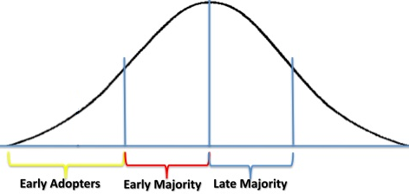

Who really has the problem?
Know they have the problem
Activity looking to solve it

Slide 13
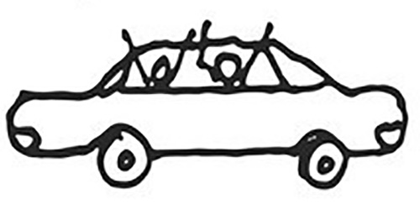
Stakeholders
User
Influencer
Recommender
Decision Maker
Economic Buyer
Saboteur
User – teen daughter
Influencer – car magazine
Recommender – family friend
Decision Maker – mom
Economic Buyer – grandmother
Saboteur – sibling

Slide 14
Core Assumptions – your solution
What are the current/other solutions for the problems/needs?
How is your solution unique/better?

Slide 15
Your biggest competitors
Doing nothing
Doing it the same way they always have

Slide 16
How Is Your Solution Unique/Better?
Common examples: bigger, cheaper, stronger, faster
Stronger examples:
On-demand (Uber)
Eco-friendliness (Tesla)
Seamlessness (Turbo-Tax)
Social consciousness (TOMS)
All-in-one (iPhone)

Slide 17
What are your riskiest assumptions?

Slide 18

Minimum Viable Products

Slide 19
MVP – Minimum Viable Product
Minimum Viable Product (MVP) - a minimum set of features that is enough to deploy the product and test key assumptions about customers' interactions with the product.
It reduces risk and avoids devoting time, money and creative energy to a product or service that doesn’t have a customer

Slide 20
MVP Examples
Dropbox – used explainer video
Zappos – faked it until they made it
Komae – tested on guinea pigs
BeMyDD – kept it old school

Slide 21
Embrace the pivot
Pinterest – recognized how users were actually using their product was different than intended
Instagram – slimmed down their product features to the most popular one

Slide 22
Good luck and thank you!

